Slide 1
CAREER CRAFTER
- A RESUME SCREENING WEBSITE
Presented by: | Guided by:
1. ROSHINI R, 7376212CB140, CSBS 2. AKSHAYA R, 7376212CB103, CSBS 3. LAKSITA V S, 7376212CB127, CSBS | Dr. PRIYA L HOD/CSBS

Slide 2
Objective
Objective: Streamline resume review for efficient hiring.
Automation: Assist recruiters by automating initial resume evaluation.
Efficiency: Speed up the review process, handling high volumes.
Data Insights: Collect and analyze data for informed hiring decisions.
Time Savings: Free up recruiters for higher-value tasks, improving hiring decisions and workforce productivity.

Slide 3
Problem Description
Recruiters and hiring managers often rely on traditional resume screening techniques when evaluating job applicants. From reviewing resumes for keywords to those infamous cover letters, it can be easy to miss the mark when it comes to the evaluation process. When it comes to traditional resume screening, there is often a problem with inconsistencies in evaluation criteria. Without being able to see a candidate in person, or being able to ask them questions relevant to their job, recruiters are left with only the information from a candidate’s resume and cover letter.

Slide 4
Literature Survey
Resume Screening is a very important step in the hiring process
Even today, many companies are following the traditional resume screening process Category Resume Analyzing the Data DL Classifiers Split the Data and Tokenize the features And labels. Resume after excess Words removal Graph is generated Using model’s test Score and accuracy Allocating Resumes Into category as input
Even though many efficient systems were proposed to perform resume screening operations, due to some problems, the systems are not efficient as expected.
Resume Screening using Machine Learning approaches has some issues like a time consuming, not being user friendly, etc.
Resume Screening using Artificial Intelligence approaches has some issues with input/output format, single resume acceptance for a time (which leads to a lot of time to screen all the resumes), etc.
Resume Screening using Deep Learning has issues like complex architecture (like coupling between any two blocks of code), inefficient, etc.

Slide 5
Scope of the Project
Promising Scope: Advancing tech, high demand for efficient hiring, and the need for objectivity make resume screening apps promising.
Efficiency Boost: Automation saves time and effort, appealing to organizations of all sizes.
User-Friendly Focus: Intuitive interfaces are crucial for HR, ensuring efficiency.
Rising Demand: Competitive job market fuels the need for efficient candidate screening.
Notes:
End of saru part

Slide 6
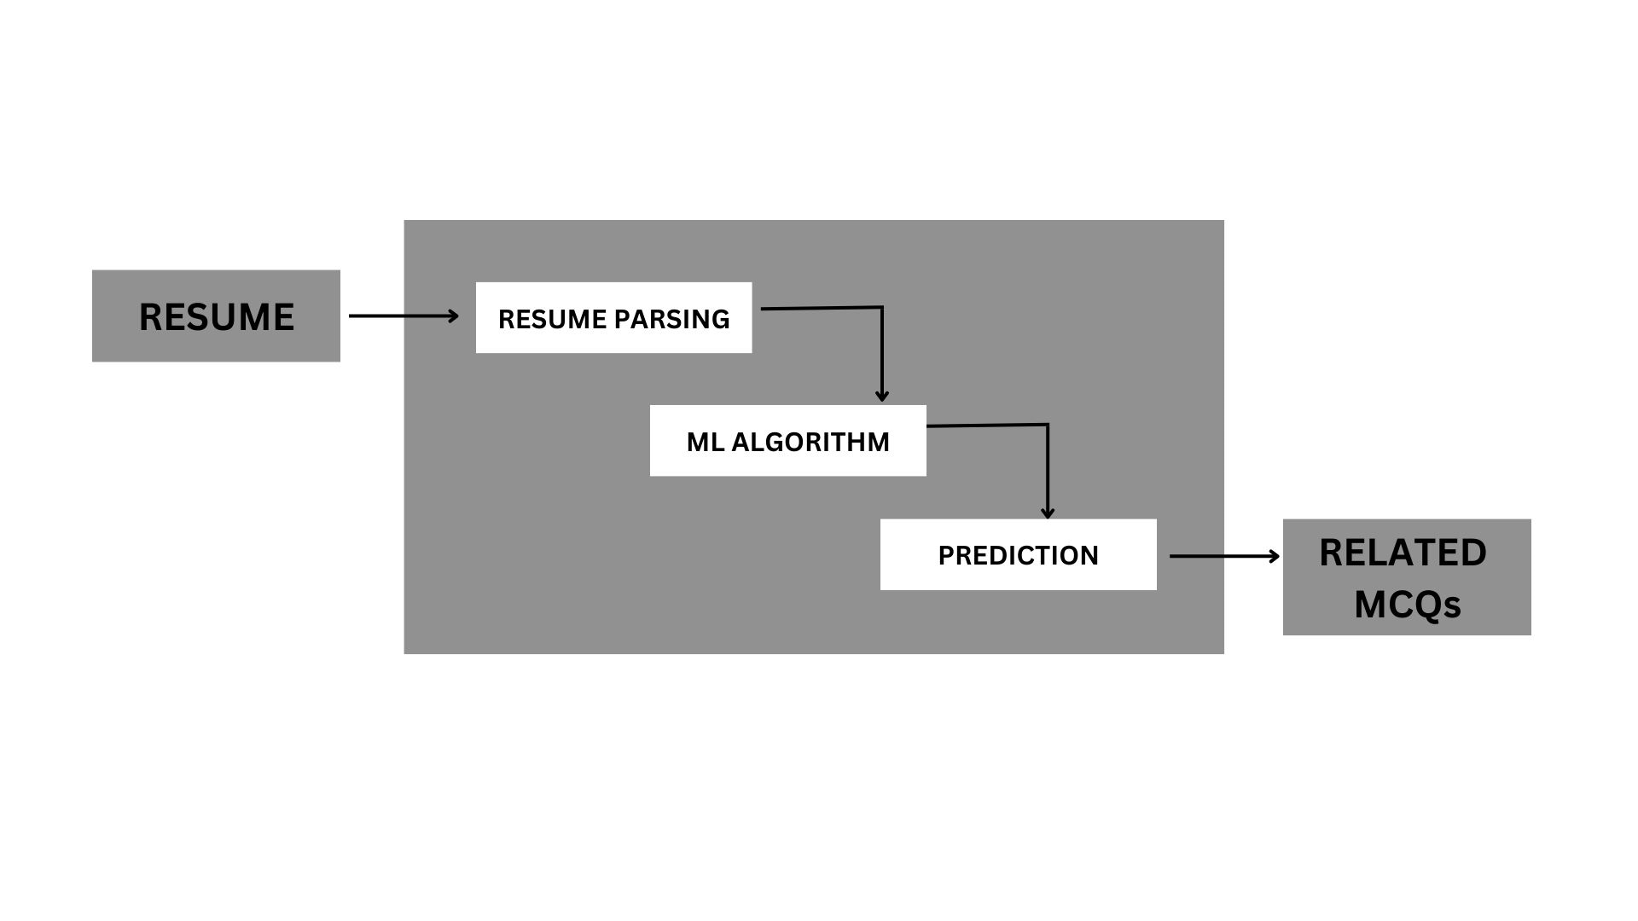
Proposed Methodology
Understanding the problem and exploring an optimal solution.
Identify the technical stack of the project.
Create a prototype of the project.
Use NLP techniques to extract the key words from resume.
Analyse various ML algorithms to predict the correct job.
Integrate the ML model into website.
Fig.1 Proposed Plan

Slide 7
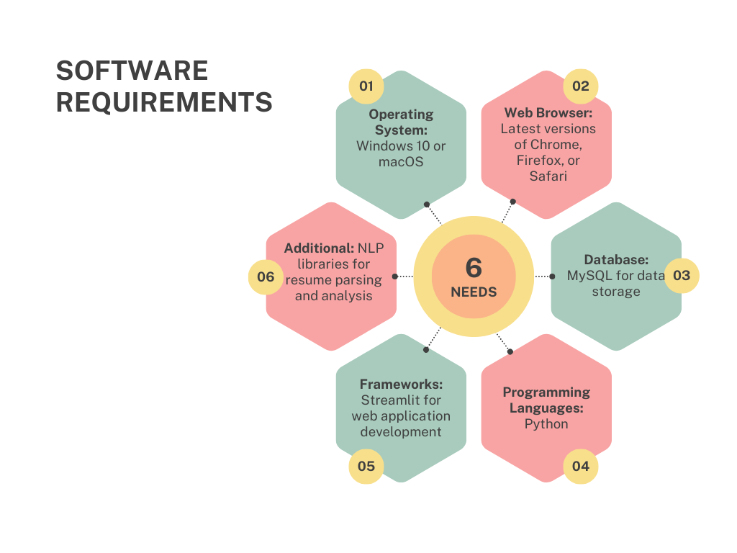
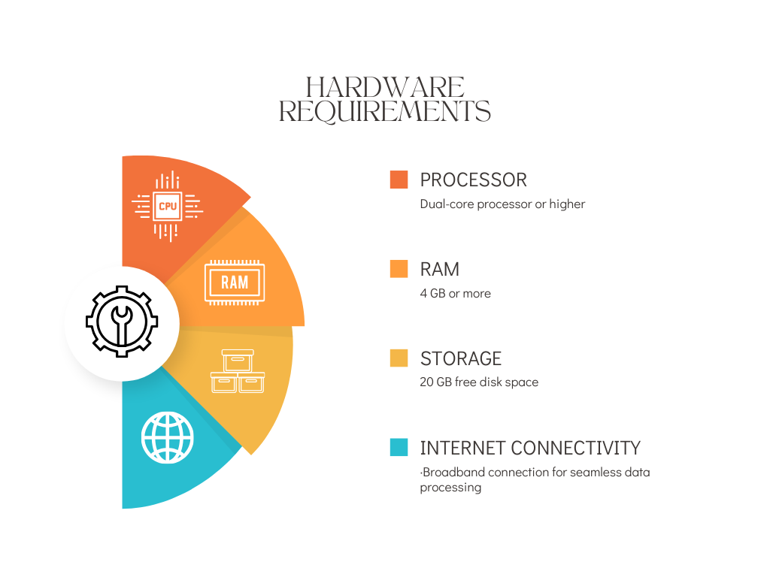
REQUIREMENTS

Slide 8
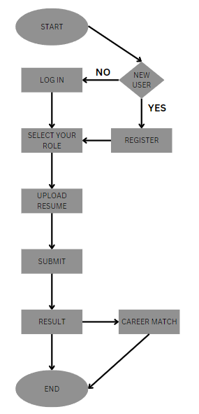
Flow Diagram
STEP 1
Dataset: Collect resumes
STEP 6
Testing: Ensure functionality
STEP 2
Preprocess: Clean data
STEP 5
Integration: NLP web
STEP 3
Model: Train ML
STEP 4
Interface: Design web
Fig.1 Overall Flow
Fig.2 ML Model Flowchart

Slide 9
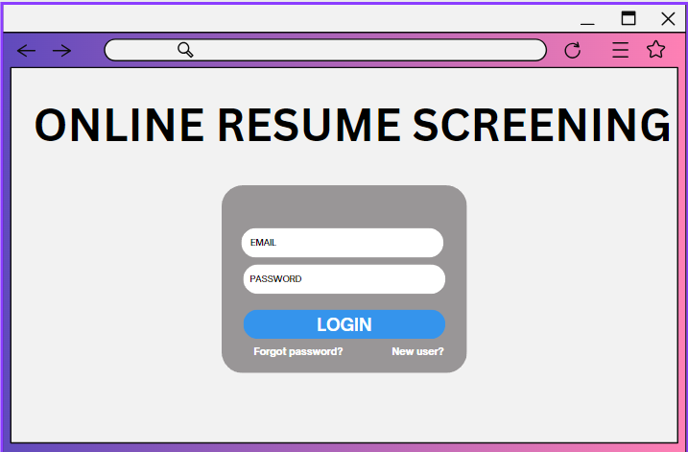
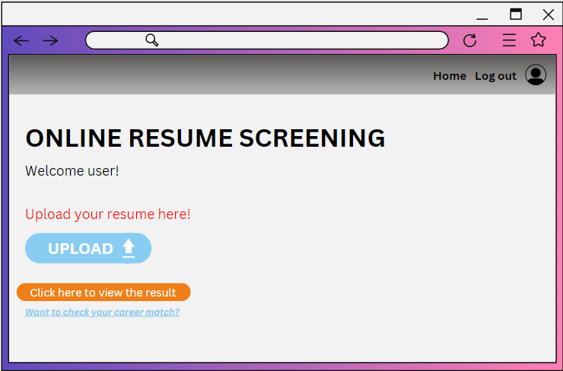
Work plan
-prototype designed using CANVA
Fig.1 First Page
Fig.2 Second Page
Notes:
saru

Slide 10
Novelty of the Project
Comparing resume with the predicted job occupation.
ML model – Naive Bayes Algorithm.
Naive Bayes Algorithm – yields 80% accuracy than other algorithm.
Career match option enabled.
Predicted career related emails for the common users.
Suggesting predicted job related questions for the recruiters.

Slide 11
Conclusion
Solution proposed.
Requirements are gathered.
Research on optimal use of ML algorithm was made.
Based on this a prototype model was created.

Slide 12
Contributions to the Work
ROSHINI R | Prototype designing, Model building
AKSHAYA R | Backend, Dataset collection
LAKSITA V S | Technical stack search

Slide 13
Reference(s)
Rutuja Patil et al., “Resume Evaluation System Based on AI,” International Research Journal of Engineering and Technology, vol. 7, no. 7, pp. 2782-2784, 2020. [Publisher Link]
V. V. Dixit et al., “Resume Sorting using Artificial Intelligence,” International Journal of Research in Engineering, Science and Management, vol. 2, no. 4, pp. 423-425, 2019. [Google Scholar] [Publisher Link]
Pradeep Kumar Roy, Sarabjeet Singh Chowdhary, and Rocky Bhatia, “A Machine Learning Approach for Automation of Resume Recommendation System,” Procedia Computer Science, vol. 167, pp. 2318-2327, 2020. [CrossRef] [Google Scholar] [Publisher Link]
G. Vadivu, and K. Sornalakshmi, “Applying Machine Learning Algorithms for Student Employability Prediction Using R,” International Journal of Pharmaceutical Sciences Review and Research, vol. 43, no. 1, pp. 38-41, 2017. [Google Scholar] [Publisher Link]

